Slide 1
Natural Language Processing
General Applications of AI
Focus on Sentiment Analysis and Chatbots

Slide 2
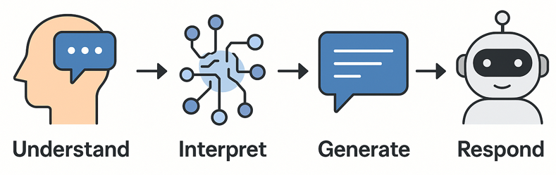
Introduction to NLP
What is Natural Language Processing (NLP)?
Definition: “NLP is the science of extracting meaning and intent from human language in a machine-readable format.”
NLP = AI + Human Language
NLP is a subfield of Artificial Intelligence focused on enabling machines to:
Understand language (e.g., meaning of words, grammar)
Interpret context and intent (e.g., user queries)
Generate natural responses (e.g., AI chat replies)
Respond appropriately (e.g., via voice/text/chat)
In short: It helps machines “read, listen, speak, and write” like humans — in multiple languages and contexts

Slide 3
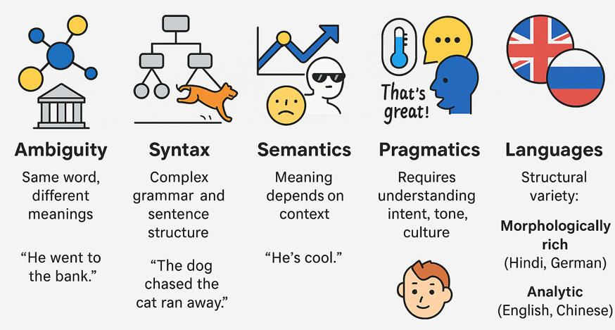
Introduction to Natural Language Processing
Why is NLP Challenging?

Slide 4
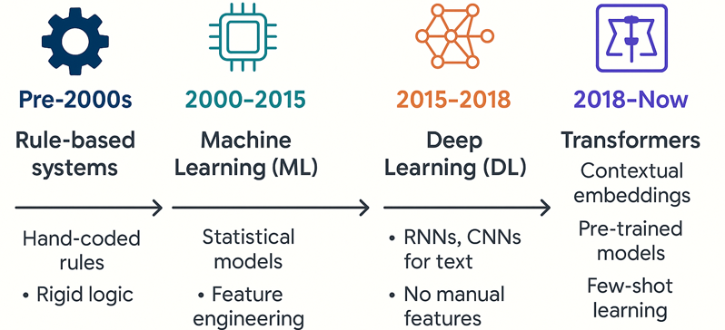
Introduction to Natural Language Processing
Evolution of NLP Techniques
Today’s NLP models like ChatGPT, BERT, and T5 use transformer-based architectures trained on massive datasets.

Slide 5
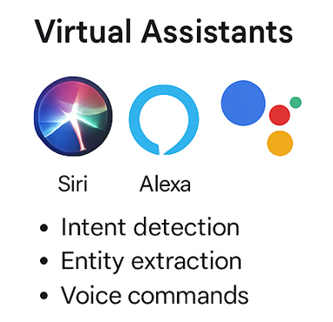
Introduction to Natural Language Processing
Key NLP Applications in the Real World
Virtual Assistants
Examples: Siri, Alexa, Google Assistant
Voice command processing
Intent detection (e.g., "Set an alarm for 7 AM")
Named entity recognition (e.g., places, dates)

Slide 6
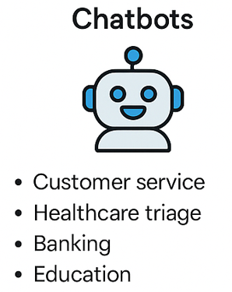
Introduction to NLP
Key NLP Applications in the Real World
Chatbots
Use Cases:
Customer support (e.g., FAQs, product queries)
Healthcare (symptom checking, mental health)
Banking (account queries, transactions)
Education (AI tutors, Q&A systems)

Slide 7
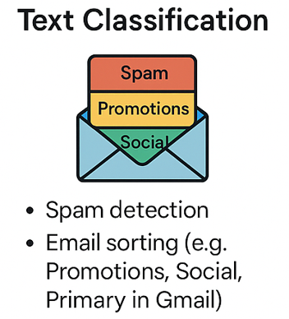
Introduction to Natural Language Processing
Key NLP Applications in the Real World
Text Classification
Spam detection (e.g., Gmail spam filters)
Inbox sorting (Primary, Social, Promotions)
Ticket prioritization (for customer service workflows)

Slide 8
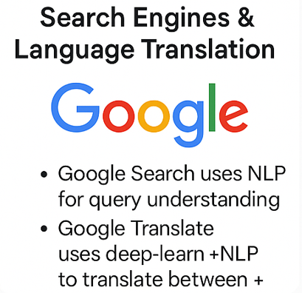
Introduction to NLP
Key NLP Applications in the Real World
Search Engines & Language Translation
Google Search uses NLP to understand query intent
Google Translate leverages deep learning + NLP for multilingual translation (100+ languages)

Slide 9
Sentiment Analysis
What is Sentiment Analysis?
Sentiment Analysis is the application of NLP and ML to determine the emotional tone expressed in a piece of text.
Classify a sentence or document into one of the sentiment categories:
Positive (“The service was excellent!”)
Neutral (“The product arrived yesterday.”)
Negative (“This was a terrible experience.”)
Common Use Cases
Product and movie reviews, Social media monitoring,
Customer feedback and support analysis, Public opinion analysis in politics or marketing

Slide 10
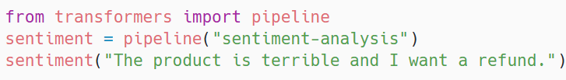
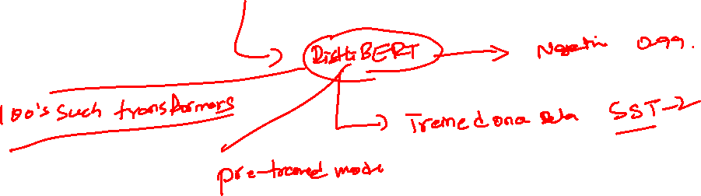
Sentiment Analysis
What is Sentiment Analysis?

Slide 11
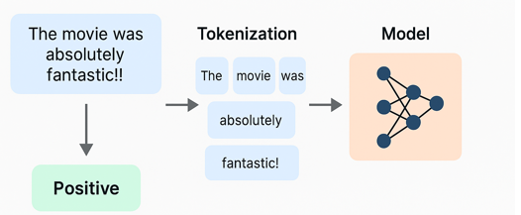
Sentiment Analysis
What is Sentiment Analysis?
Sentiment Analysis is the application of NLP and ML to determine the emotional tone expressed in a piece of text.

Slide 12
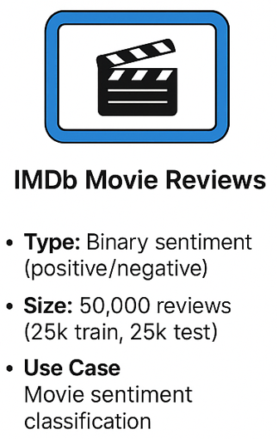
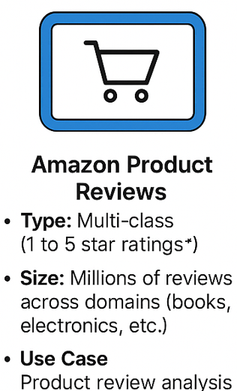
Sentiment Analysis
Sentiment Analysis: Common Databases
IMDb Movie Reviews
Type: Binary sentiment (positive/negative)
Size: 50,000 reviews (25k train, 25k test)
Use Case: Movie sentiment classification
Amazon Product Reviews
Type: Multi-class (1 to 5 star ratings)
Size: Millions of reviews across domains (books, electronics, etc.)
Use Case: Product review analysis, customer satisfaction, recommendation engines

Slide 13
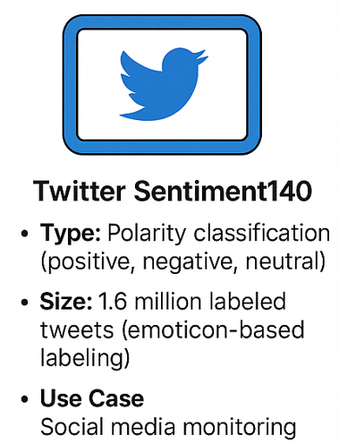
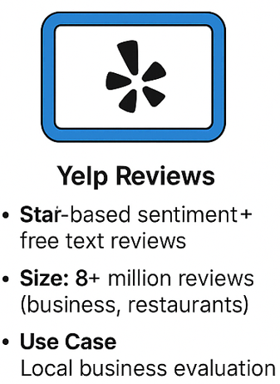
Sentiment Analysis
Sentiment Analysis: Common Databases
Twitter Sentiment140
Type: Polarity classification (positive, negative, neutral)
Size: 1.6 million labeled tweets (emoticon-based labelling)
Use Case: Social media monitoring, brand sentiment, political sentiment
Yelp Reviews
Type: Star-based sentiment + free text reviews
Size: 8+ million reviews (business, restaurants)
Use Case: Local business evaluation, customer service feedback

Slide 14
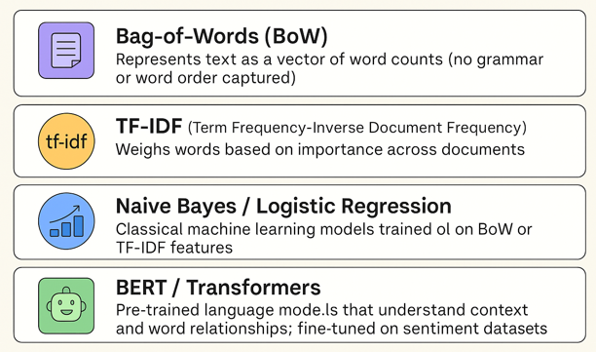
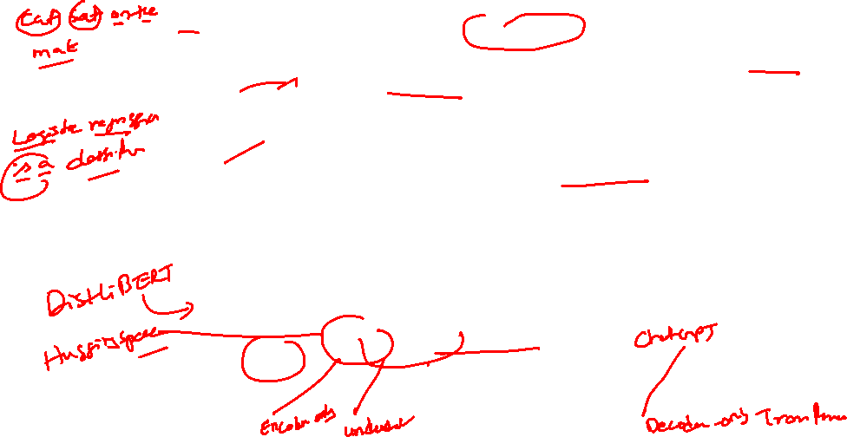
Sentiment Analysis
Popular Techniques for Sentiment Analysis

Slide 15
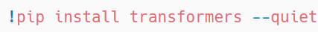
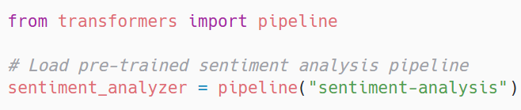

Sentiment Analysis
Live Demonstration: Predict Sentiment on a Sentence
Step 1: Install the Required Library
Step 2: Import and Load the Sentiment Pipeline

Slide 16
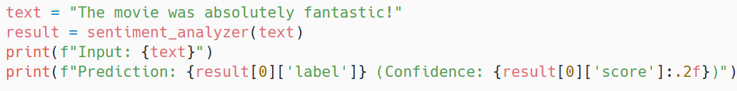

Sentiment Analysis
Live Demonstration: Predict Sentiment on a Sentence
Step 3: Enter a Sentence and Analyze
Class Activity Idea

Slide 17
Sentiment Analysis
Applications of Sentiment Analysis
Social Media Monitoring
Detect public opinion about brands or events in real time
Track trends across platforms like Twitter, Facebook, YouTube
Product Review Summarization
Automatically summarize customer reviews from Amazon, Flipkart, App Stores
Highlight product strengths & weaknesses
Political Sentiment Tracking
Analyze sentiment on political parties, leaders, and policies
Used by media houses and election analysts
Customer Feedback Analysis
Classify feedback into positive/neutral/negative
Prioritize complaints, highlight praise, improve service

Slide 18
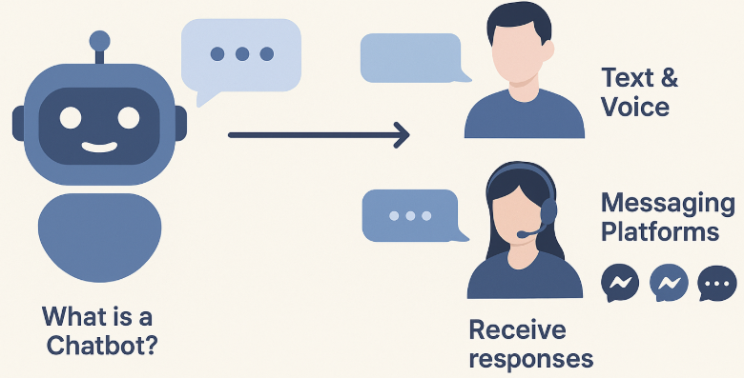
AI Chatbots
What is a Chatbot?
A chatbot is a software application designed to simulate human-like conversations through:
Text-based interfaces (web, mobile, chat windows)
Voice interactions (via smart speakers, voice assistants)
Where Are Chatbots Used?
Websites & mobile apps
Messaging platforms like:
WhatsApp
Facebook Messenger
Slack
Telegram
Primary Goal: To understand user queries and provide relevant, timely, and conversational responses — either by following rules or using AI.

Slide 19
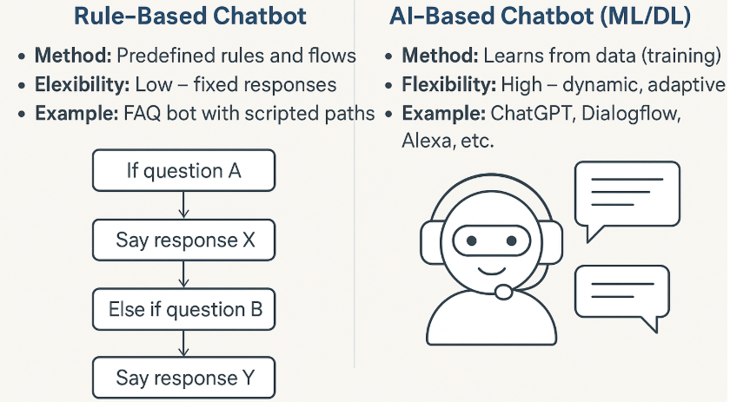
AI Chatbots
Rule-based vs AI-Based Chatbots

Slide 20
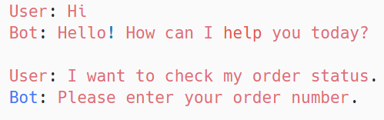
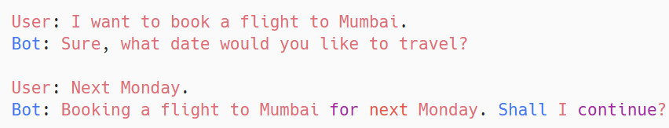

AI Chatbots
Rule-based vs AI-Based Chatbots

Slide 21
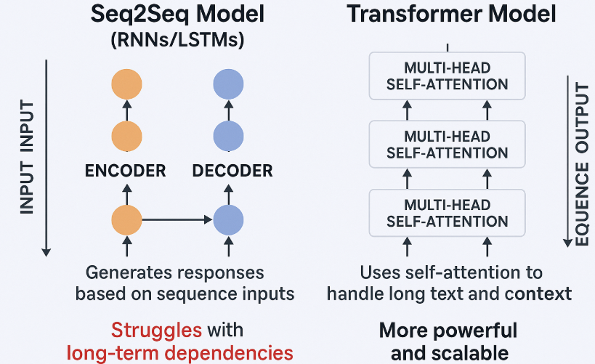

AI Chatbots
Seq2Seq vs Transformer Chatbots

Slide 22
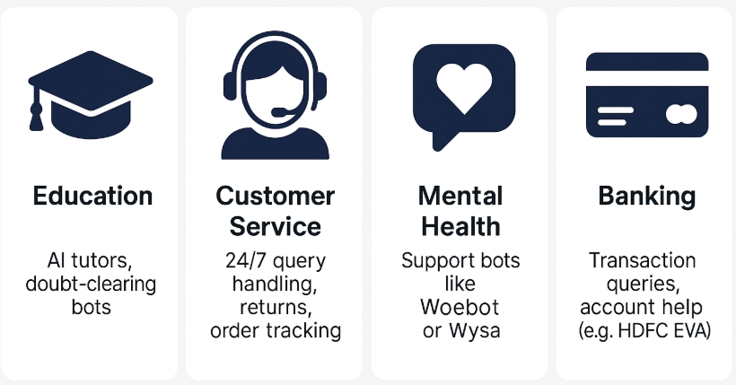
AI Chatbots
Real World Use cases of Chatbots

Slide 23
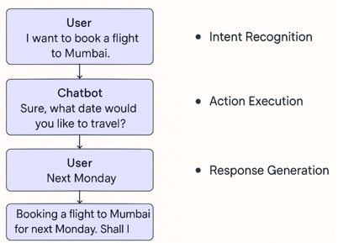

AI Chatbots
Example Chatbots

Slide 24
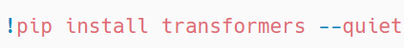
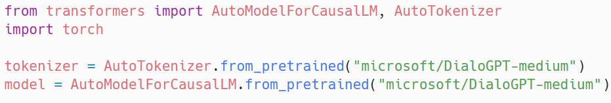


AI Chatbots Live Demo
Setup and Installation
2. Load a Pretrained Chatbot Model (DialoGPT)

Slide 25
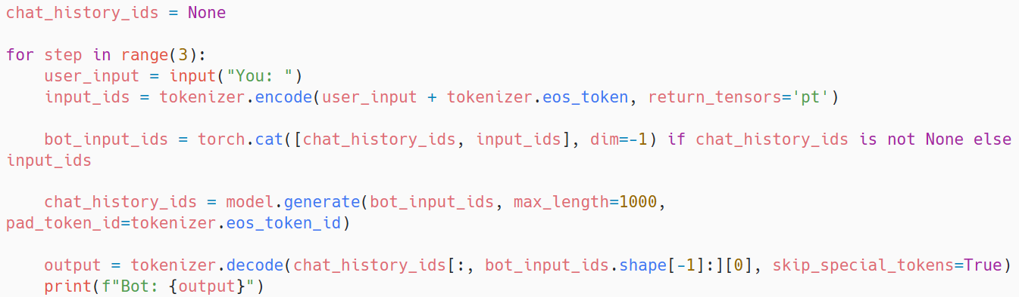

AI Chatbots Live Demo-HuggingFace Chatbot
3. Interactive Chat Function

Slide 26
Discussions, Ethics and Real World cases
What Makes Chatbots Feel “Human-Like”?
Natural language generation (tone, emotion, slang)
Context awareness (remembers previous inputs)
Personalization (adapts to user behavior)
Timely and relevant responses
ChatGPT and Alexa simulate conversation using context, tone, and fluidity.
Ethical Concerns with AI Chatbots
Bias: AI may reinforce racial, gender, or cultural stereotypes based on training data
Misinformation: Chatbots may generate false or misleading information
Impersonation: Deepfake-style bots imitating real people (e.g., fake customer support agents)

Slide 27
NLP and Ethics
Real-World Case: Microsoft Tay (2016)
Tay was a Twitter chatbot trained on live user input.
Within 24 hours, it was manipulated to generate offensive, racist tweets.
Microsoft shut it down and acknowledged the need for better safeguards.
Safety Measures in Modern Chatbots
ChatGPT: Moderation filters, refusal to answer unsafe queries
Dialogflow / Alexa: Contextual limits, intent whitelists, guardrails
Ethical AI: Explainability, transparency, fairness

Slide 28
THANK YOU

